Slide 1
Chapter 10
Textbook questions

Slide 2
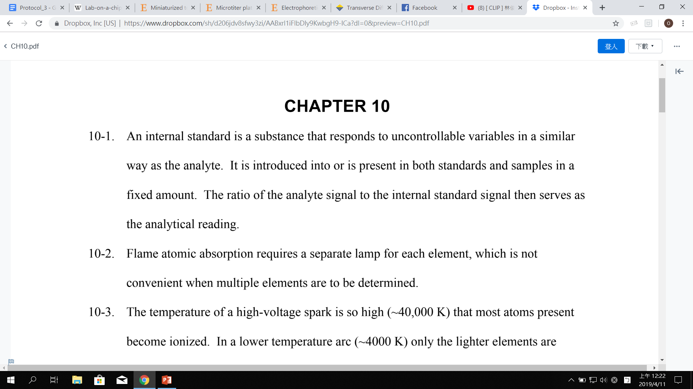
Question 10-1
What is an internal standard and why is it used?
Question 10-2
Why are atomic emission methods with an ICP source better suited for multielement analysis than are flame atomic absorption methods?

Slide 3
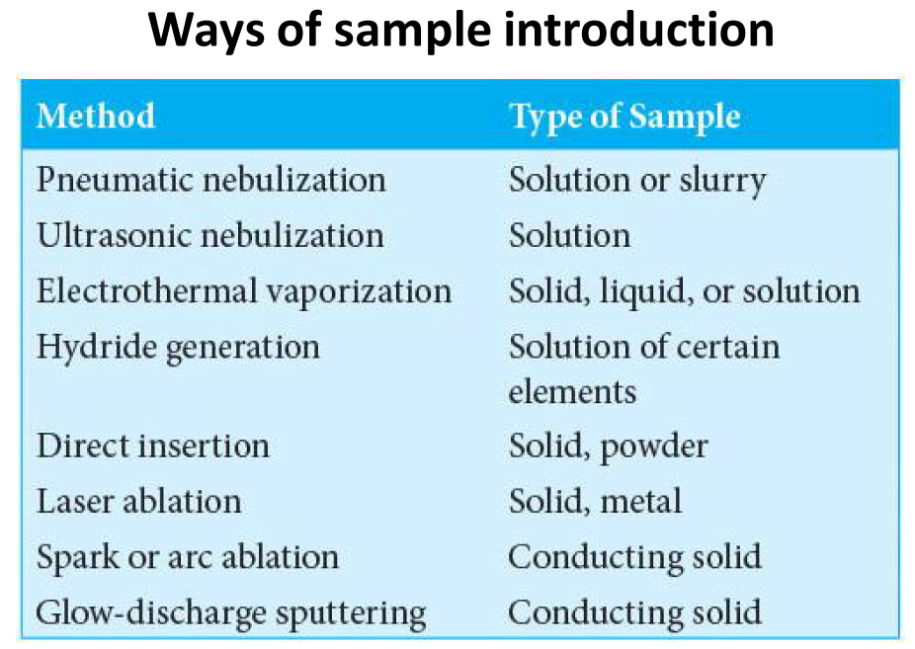
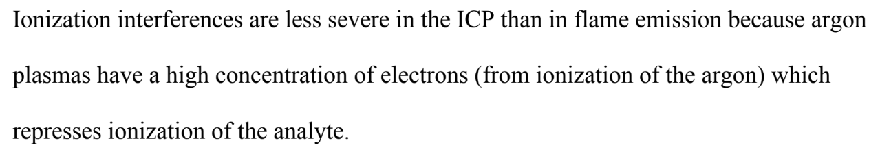
Question 10-6
Describe three ways of introducing a sample into an ICP torch.
Question 10-8
Why are ionization interferences less severe in ICP than in flame emission spectroscopy?

Slide 4
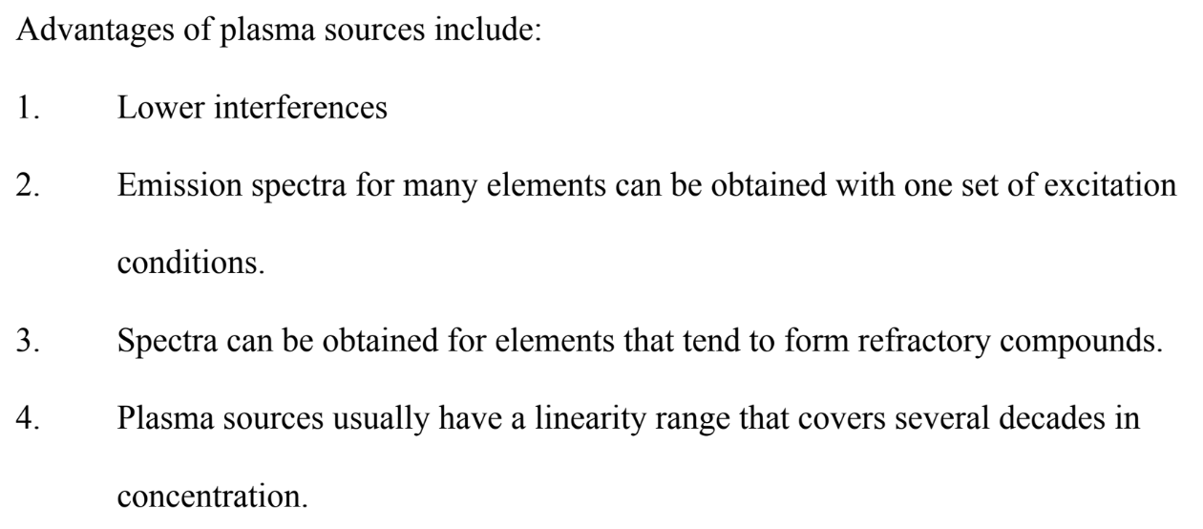
Question 10-9
What are some of the advantages of plasma sources compared with flame sources for emission spectrometry?

Slide 5
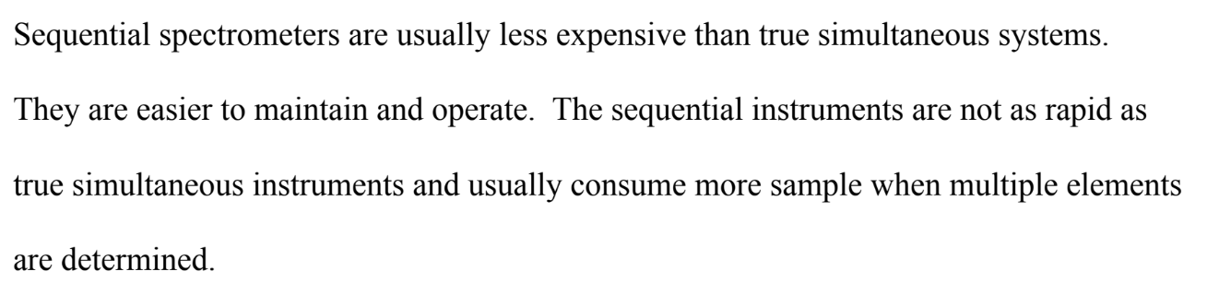
Question 10-10
Discuss the advantages and disadvantages of sequential versus simultaneous multichannel ICP spectrometers.

